Slide 1
Prototype Based Approaches

Slide 2
Agenda
Announcements
Deep Learning for Case-Based Reasoning through Prototypes
Break
The Bayesian Case Model

Slide 3
Announcements
Homework 1 Due Next Thursday (Oct. 3rd) at 11.59pm
Rest of the deadlines stand as is.
Keep us posted about any questions via canvas or office hours (preferred) or email
Hope all of you submitted CP1 and signed up for paper presentations
HW2 will be out on Monday at 11.59pm ET

Slide 4
Questions??

Slide 5
Deep Learning for Case-Based Reasoning through Prototypes
Oscar Li, Hao Liu, Chaofan Chen, Cynthia Rudin

Slide 6
Contributions
Proposed and developed a novel network architecture for deep learning
Explains its own reasoning for each prediction
Not post-hoc explanations
Prototypes learned during training
Explanations are faithful to what the network computes

Slide 7
Motivation
ML models are increasingly deployed to answer societal questions → interpretability/transparency
Radiology: Lack of transparency poses challenges to FDA approval for deep learning products
Neural nets are particularly difficult to understand because of the high degree of non-linearity

Slide 8
Related Work: Post-hoc explanations
Past: neural nets designed mainly for accuracy with post-hoc explanations
Choose network architecture first, then interpret!
Problem: post-hoc explanations may not be faithful to the model
Easy to create multiple conflicting yet convincing explanations, none of which is correct

Slide 9
Related Work: Post-hoc explanations
In some cases, post-hoc explanations themselves are not interpretable
Additional modeling is needed to make them interpretable
E.g., activation maximization

Slide 10
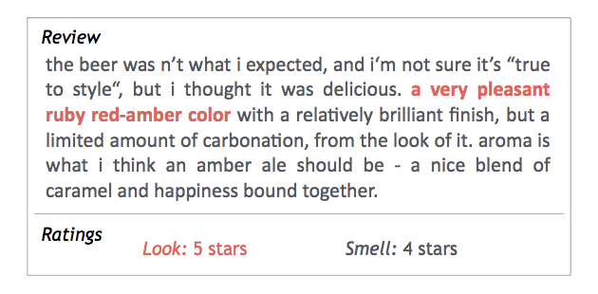
Related Work: Built-in Interpretability
Weakly-supervised image segmentation: extract important pixels belonging to images of some class
Text classification: extract parts of input as a rationale and use this for predictions

Slide 11
Related Work: Built-in Interpretability
How is current work different?
Case based reasoning (prior models: extractive reasoning)
Is one always better than the other?
Other models seem domain specific
Text, vision

Slide 12
Related Work: Prototype Classification
Prototype classification
Instance of case-based reasoning
Next paper is from this category
Present work: case-based reasoning for neural networks (classification)

Slide 13
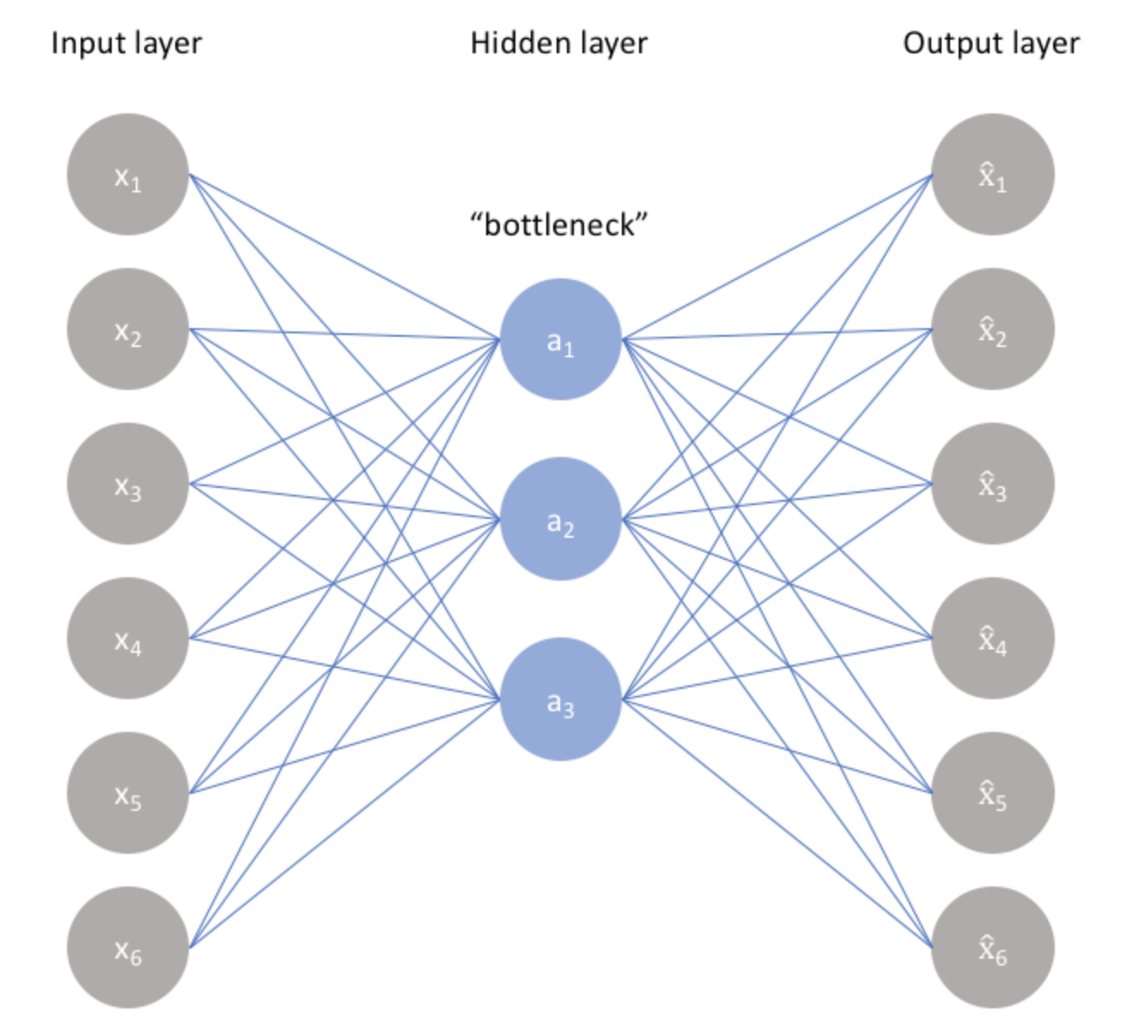
Background: Autoencoder
Non-linear Dimensionality Reduction and Reconstruction

Slide 14
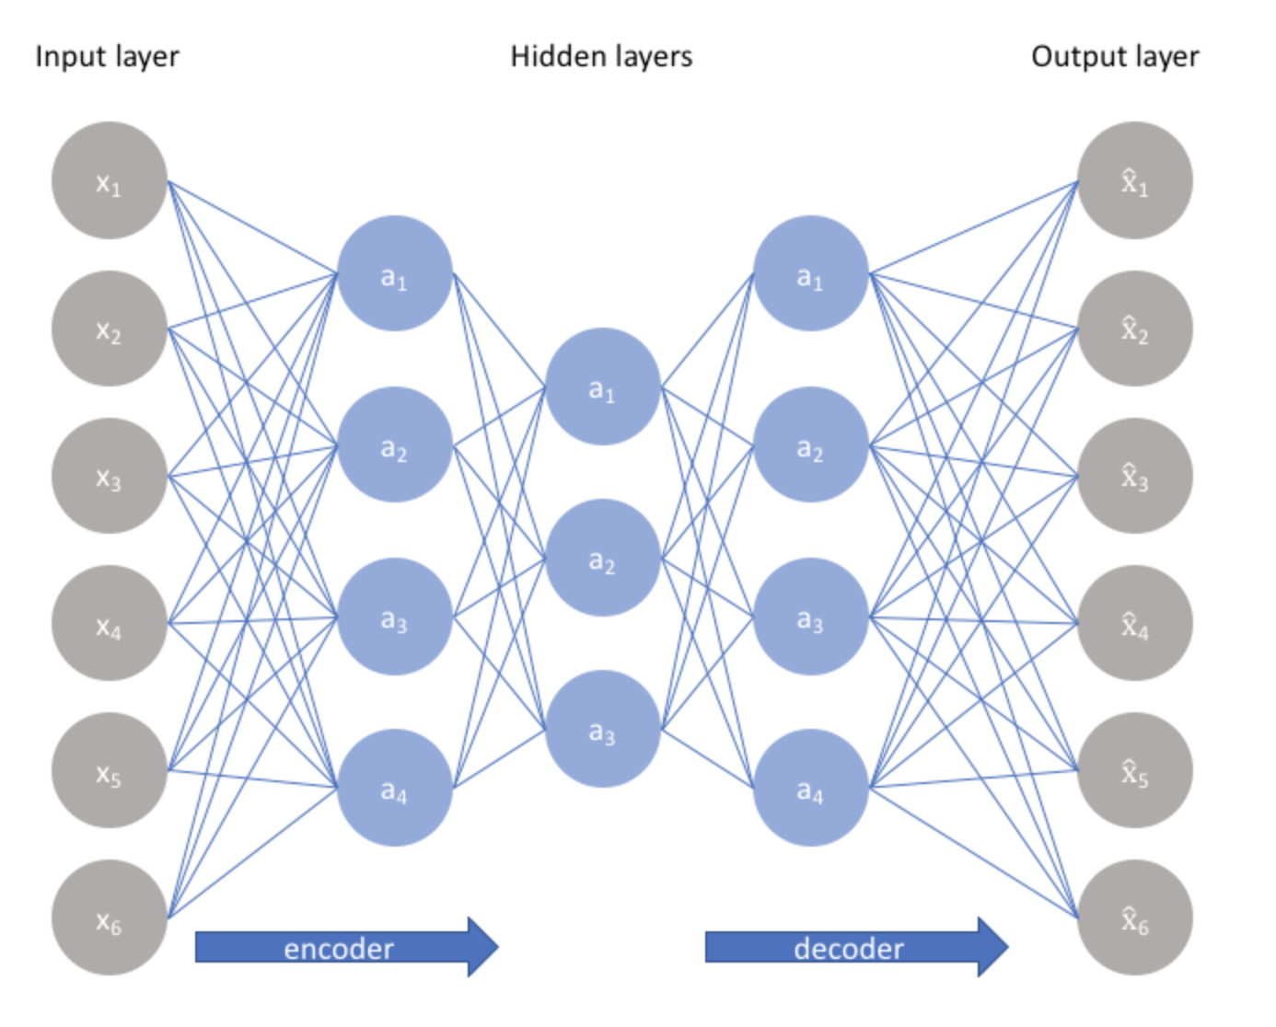
Background: Autoencoder

Slide 15
Background: Constructing an Autoencoder
Constrain the number of nodes present in the hidden layer(s) of the network,
limiting the amount of information that can flow through the network
By penalizing the network according to the reconstruction error, our model can learn the most important attributes of the input data and how to best reconstruct the original input from an "encoded" state.
The encoding will learn and describe latent attributes of the input data.

Slide 16
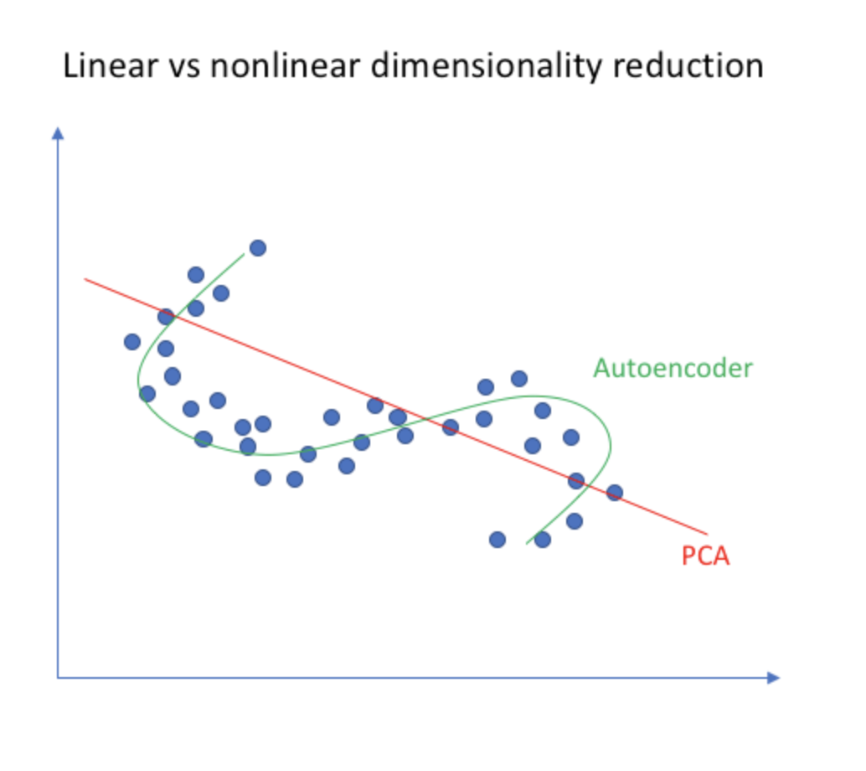
Background: Autoencoding vs. PCA

Slide 17
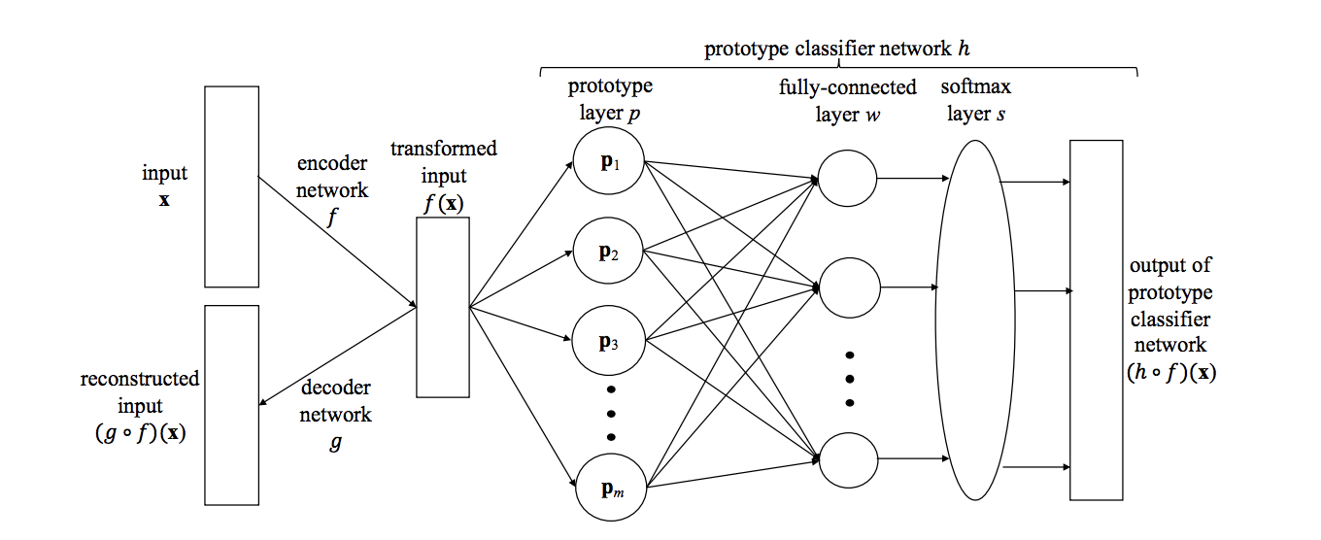
Proposed Network Architecture
Autoencoding

Slide 18
Autoencoder
R^{p}
R^{q}
q < p
R^{p}
Autoencoding

Slide 19
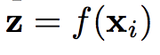
Prototype Layer
R^{p}
R^{q}
q < p
R^{p}
R^{m}
Prototype layer is responsible for computing the prototypes
Each node in layer p computes one of the above elements

Slide 20
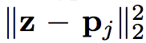
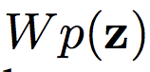
Fully Connected Layer
The fully connected layer computes weighted sums of the distances :
W is a k x m matrix
R^{p}
R^{q}
q < p
R^{p}
R^{m}
R^{k}

Slide 21
Softmax Layer
R^{p}
R^{q}
q < p
R^{p}
R^{m}
R^{k}
R^{k}
The weighted sums are normalized by the softmax layer to output
a probability distribution over K classes

Slide 22
Few points
With the above model, there could be more than one prototype per class
What if we want only one prototype per class?
Choose m = K
Constrain the matrix W to have only non-zero entry per row
More realistic to have more than one prototype per class
What do you think about the sign of entries in W matrix?
Should they be positive/negative?

Slide 23
Advantages of Proposed Architecture
Automatically learns useful features
Non-linear dimensional reduction
Suitable for high-dimensional data such as images
Prototypes vectors can be decoded and visualized
Same latent space as encoded inputs
Ability to interpret without post-hoc analysis

Slide 24
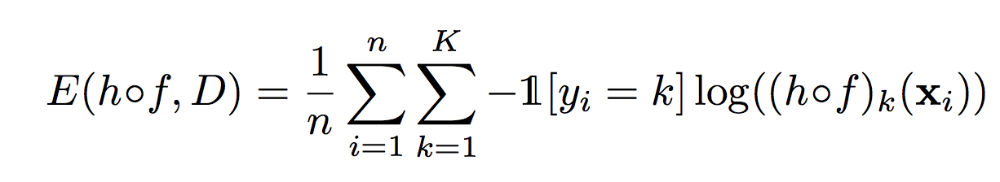
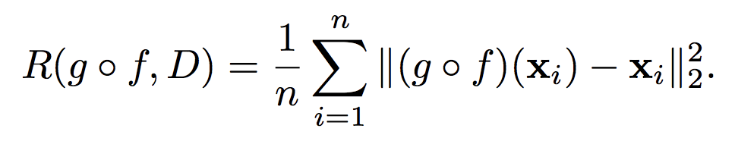
Cost Function
Cross entropy loss
Reconstruction error

Slide 25
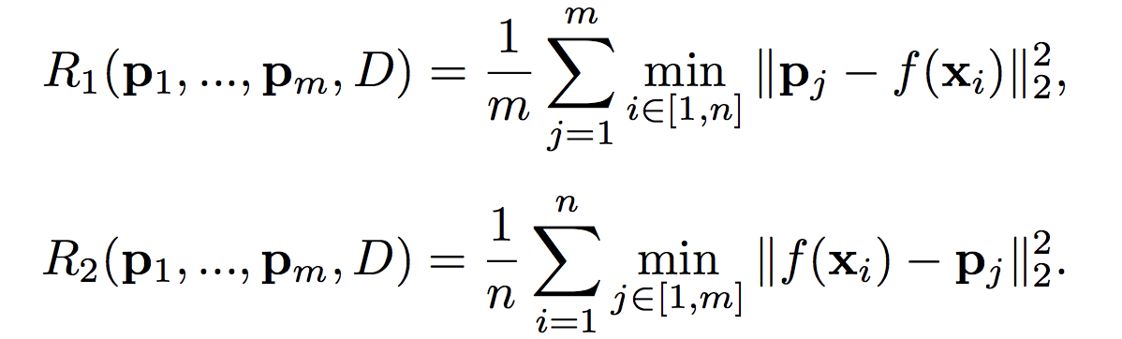
Cost Function: Interpretability Regularizers
Each prototype vector should be as close as possible
to at least one training example
Each training example should be as close as
possible to one prototype

Slide 26
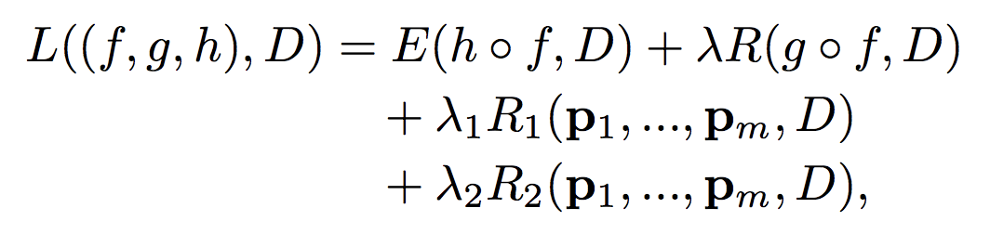
Cost Function

Slide 27
Neural Networks
Step 1: Define architecture
Step 2: Outline cost function
Step 3: Forward pass, compute derivatives, back propagate, update parameters – repeat!
Min functions are not technically differentiable
But, in practice, packages allow it
This is essentially gradient descent

Slide 28
Intuition Behind Step 3
We have weights and other parameters we need to estimate
Initialize those with random values
Make a forward pass to compute the loss function
Compute and propagate gradients backwards (proportionately) to each node
The goal is to update weights and other parameter values so as to minimize error
How to update? Which direction to move in? How much?

Slide 29
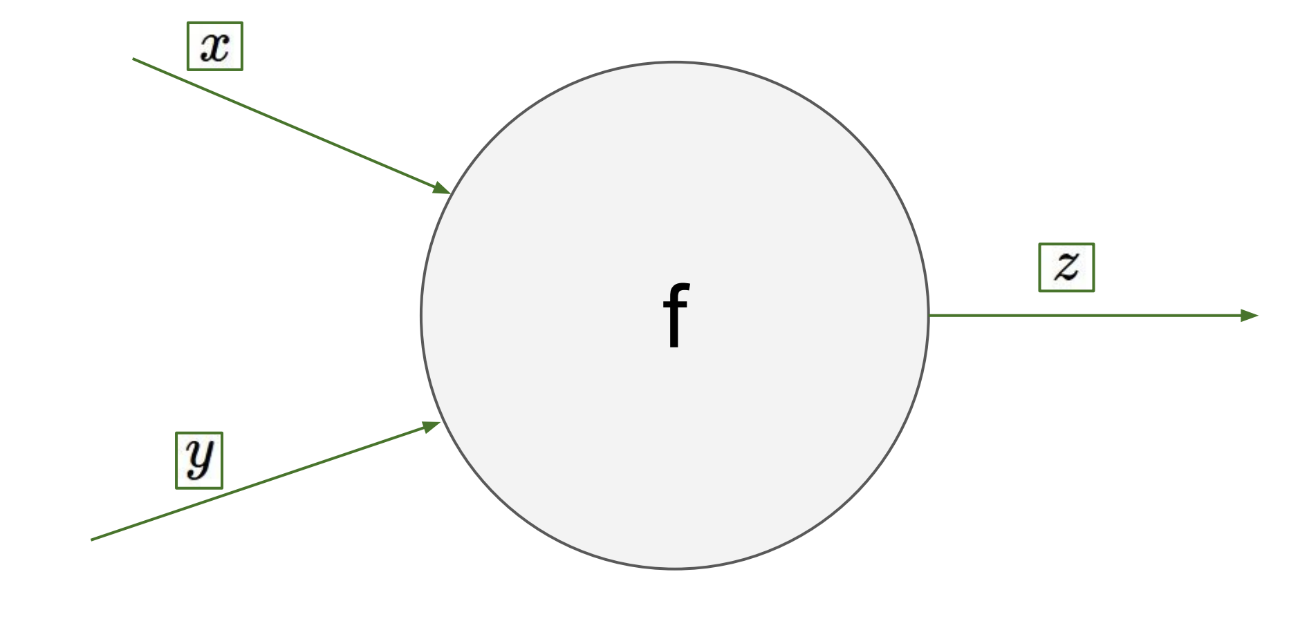
Backpropagation: Intuition

Slide 30
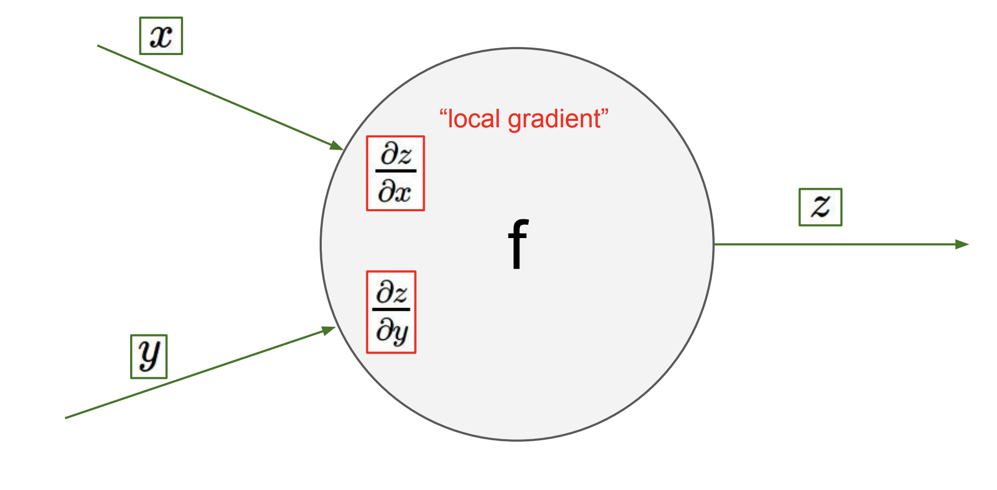
Backpropagation: Intuition

Slide 31
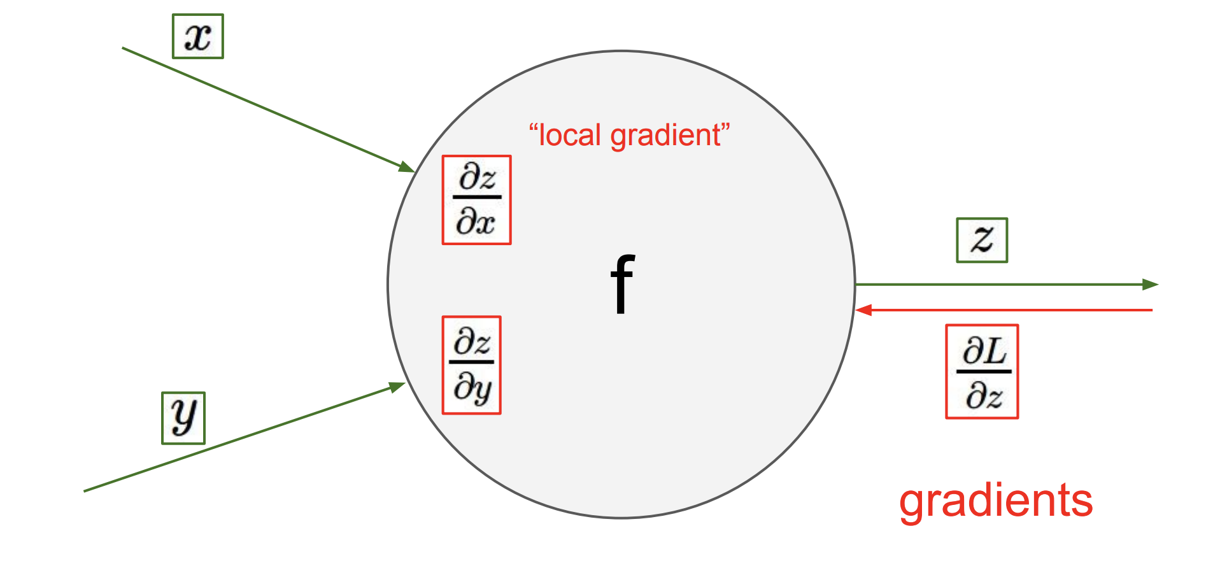
Backpropagation: Intuition

Slide 32
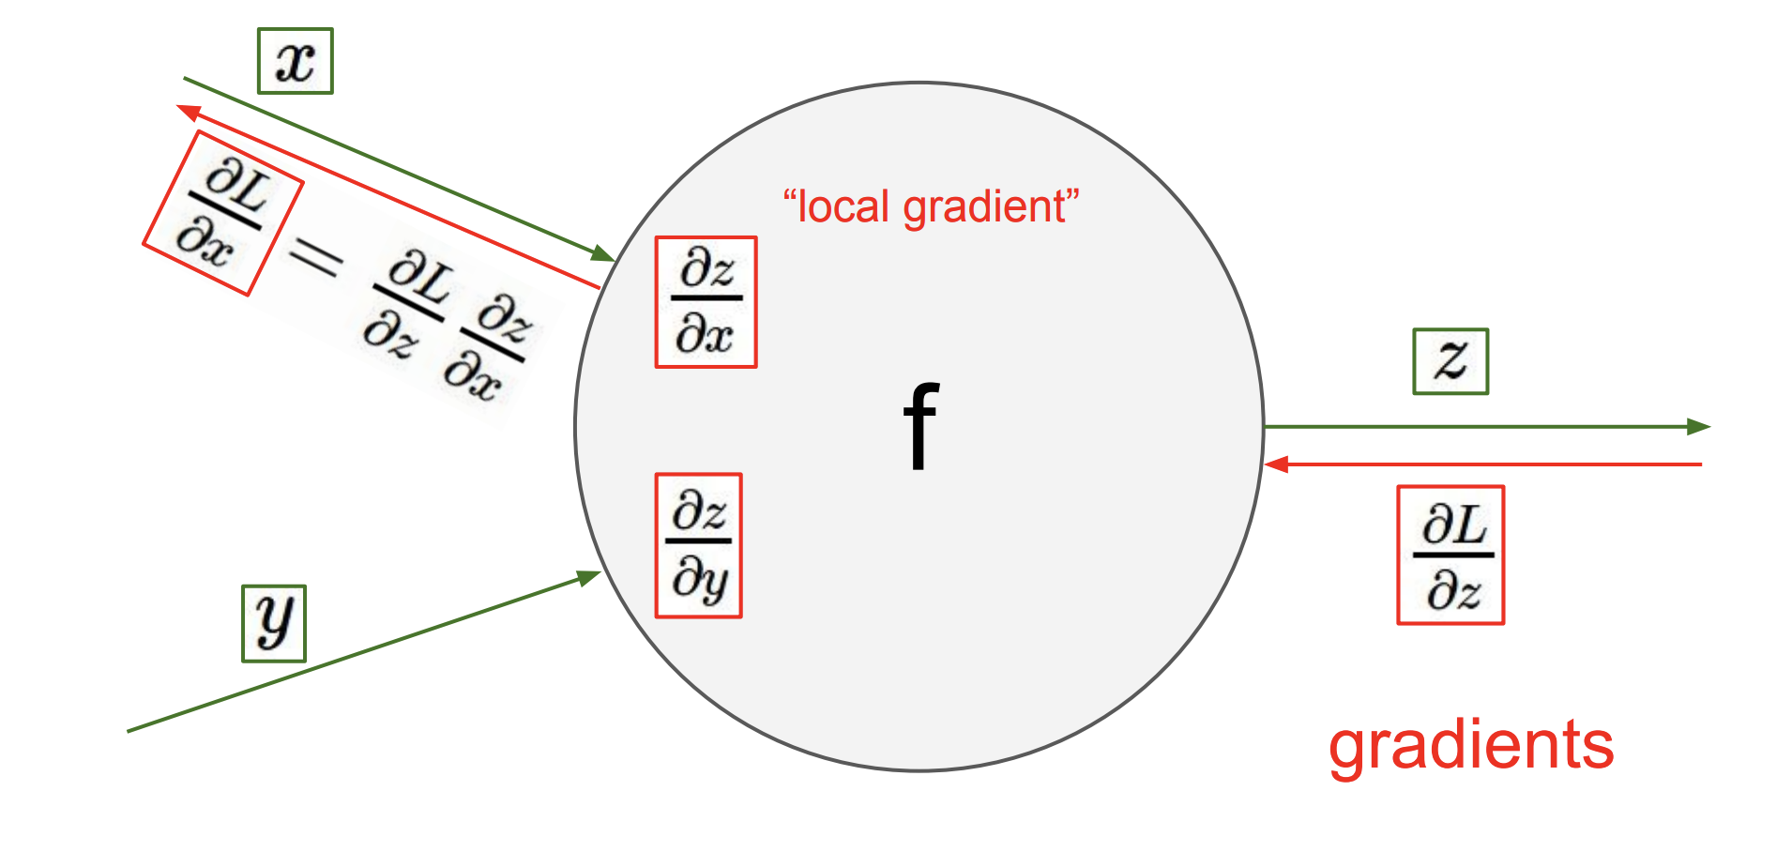
Backpropagation: Intuition
Local gradient x upstream gradient

Slide 33
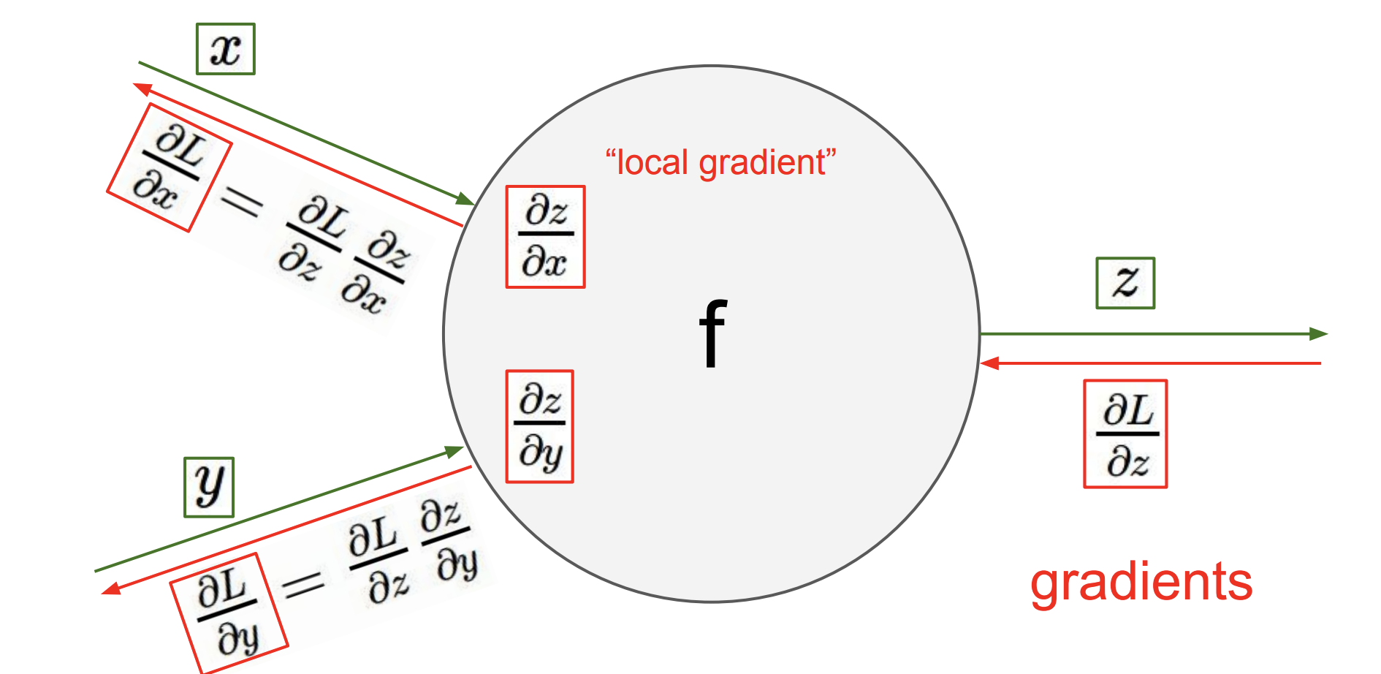
Backpropagation: Intuition
Local gradient x upstream gradient

Slide 34
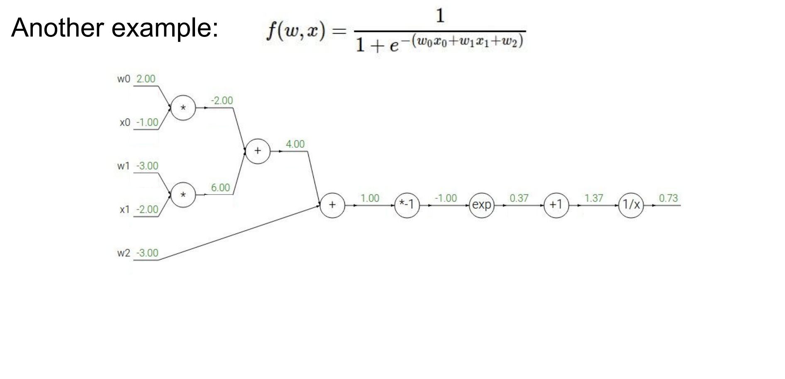
Backpropagation: Example

Slide 35
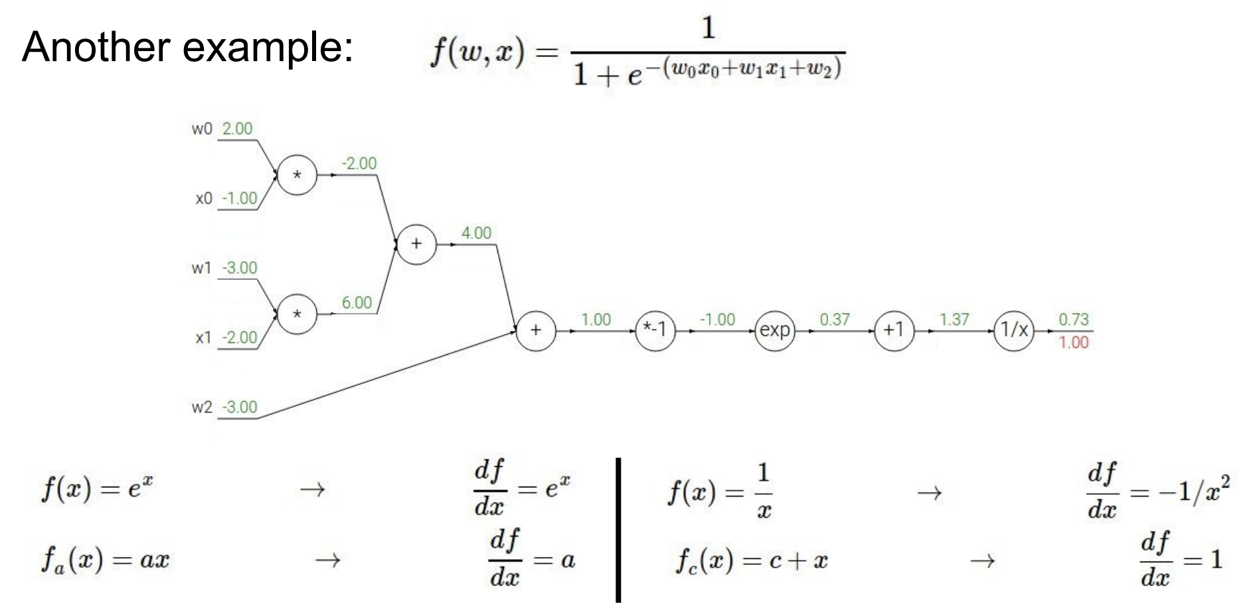
Backpropagation: Example

Slide 36
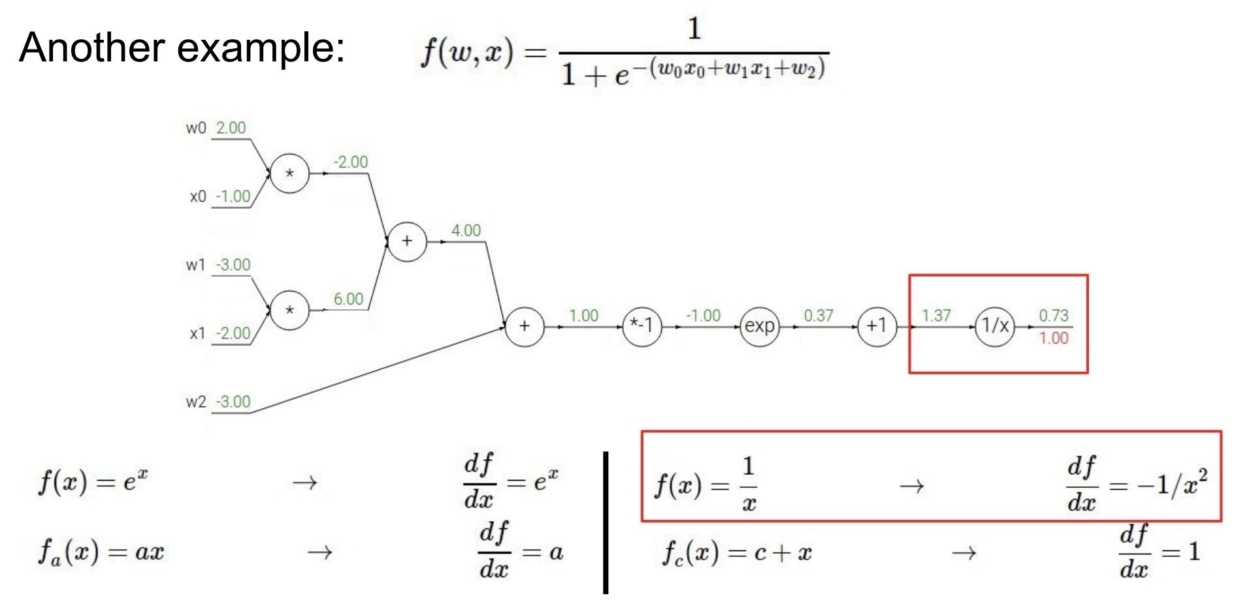
Backpropagation: Example

Slide 37
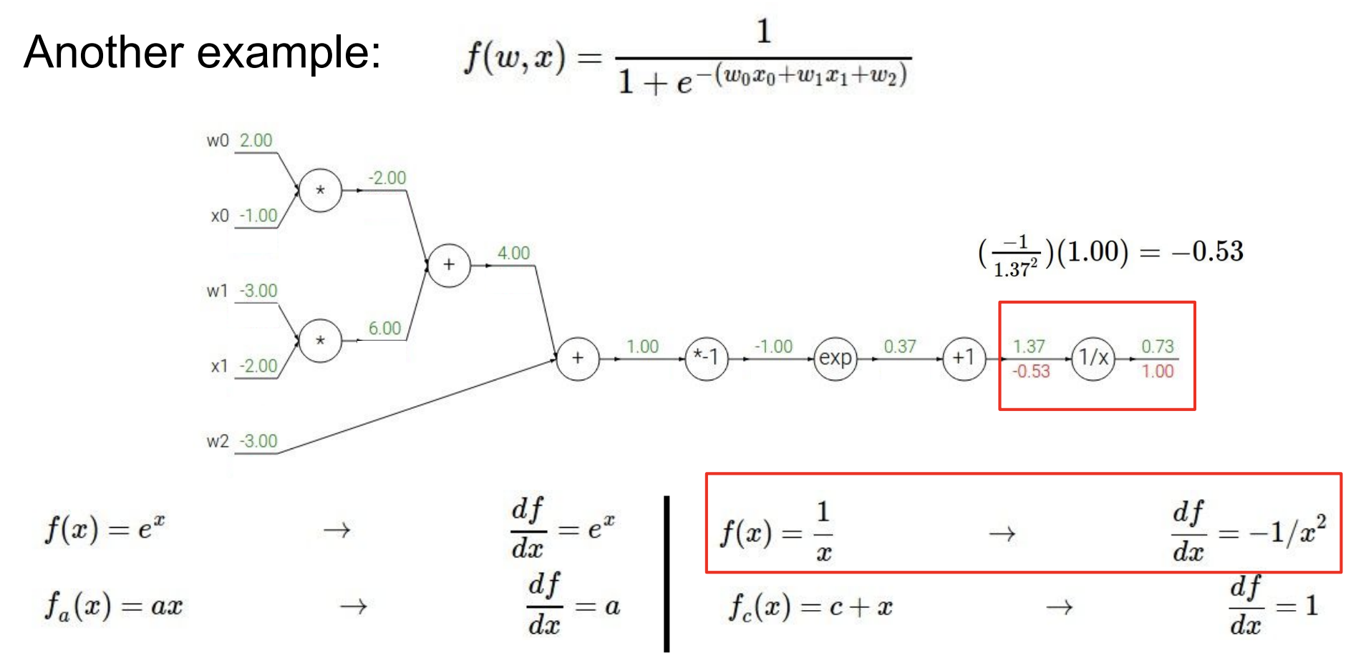
Backpropagation: Example

Slide 38
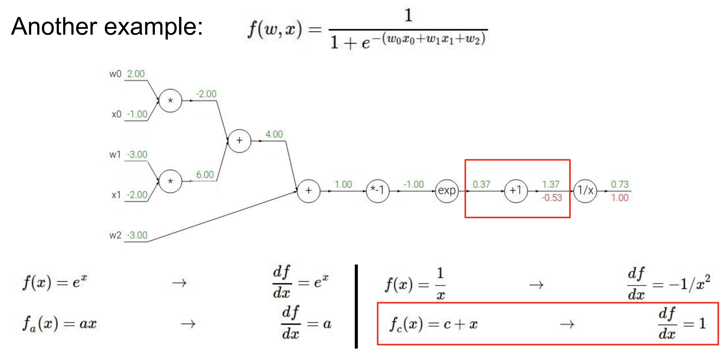
Backpropagation: Example

Slide 39
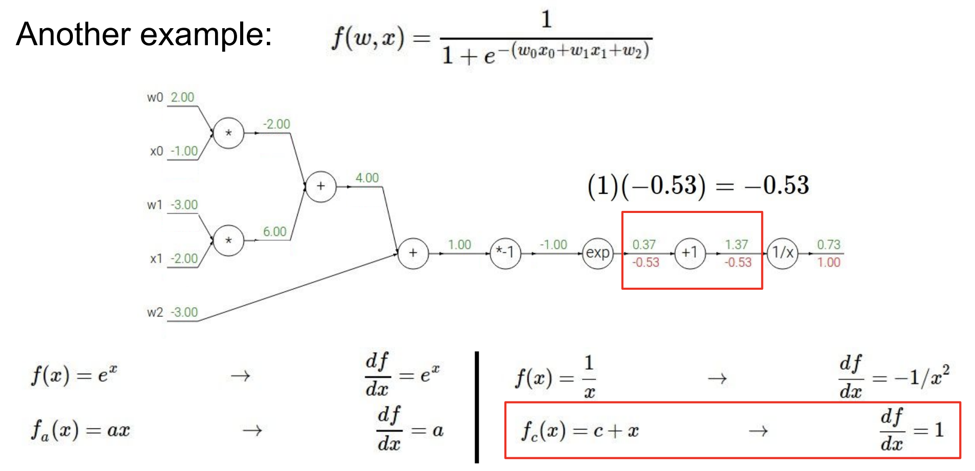
Backpropagation: Example

Slide 40
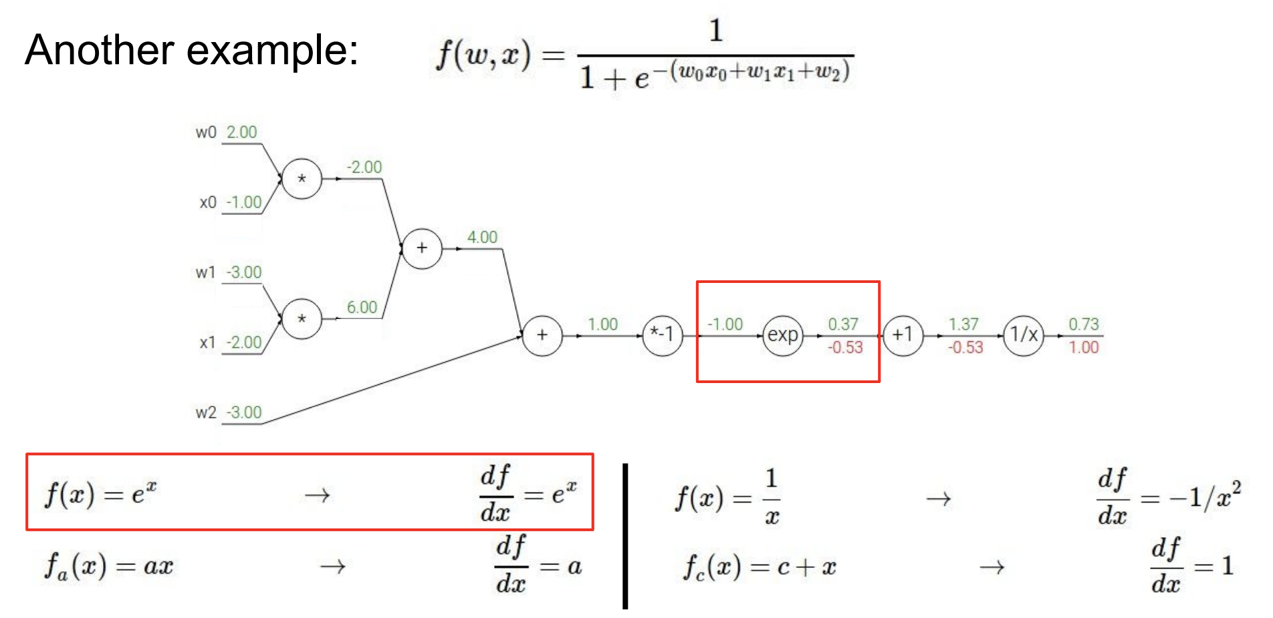
Backpropagation: Example

Slide 41
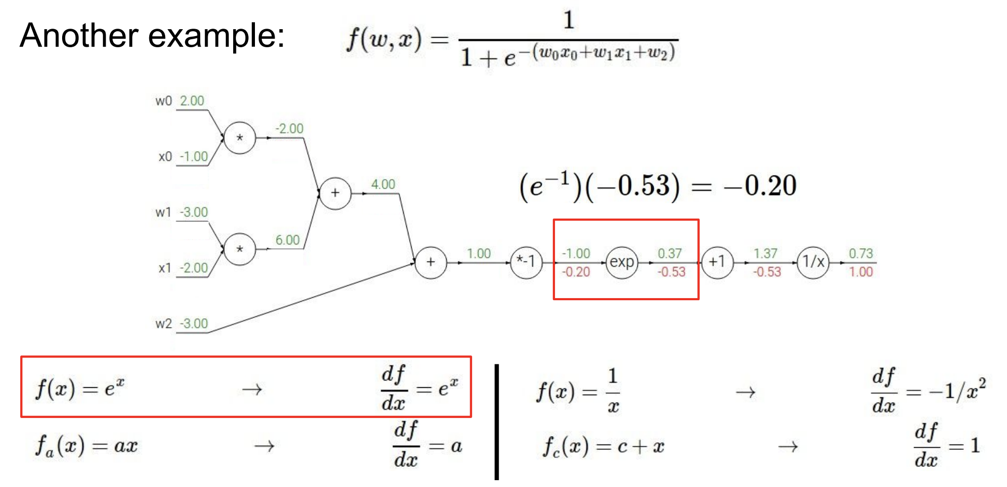
Backpropagation: Example

Slide 42
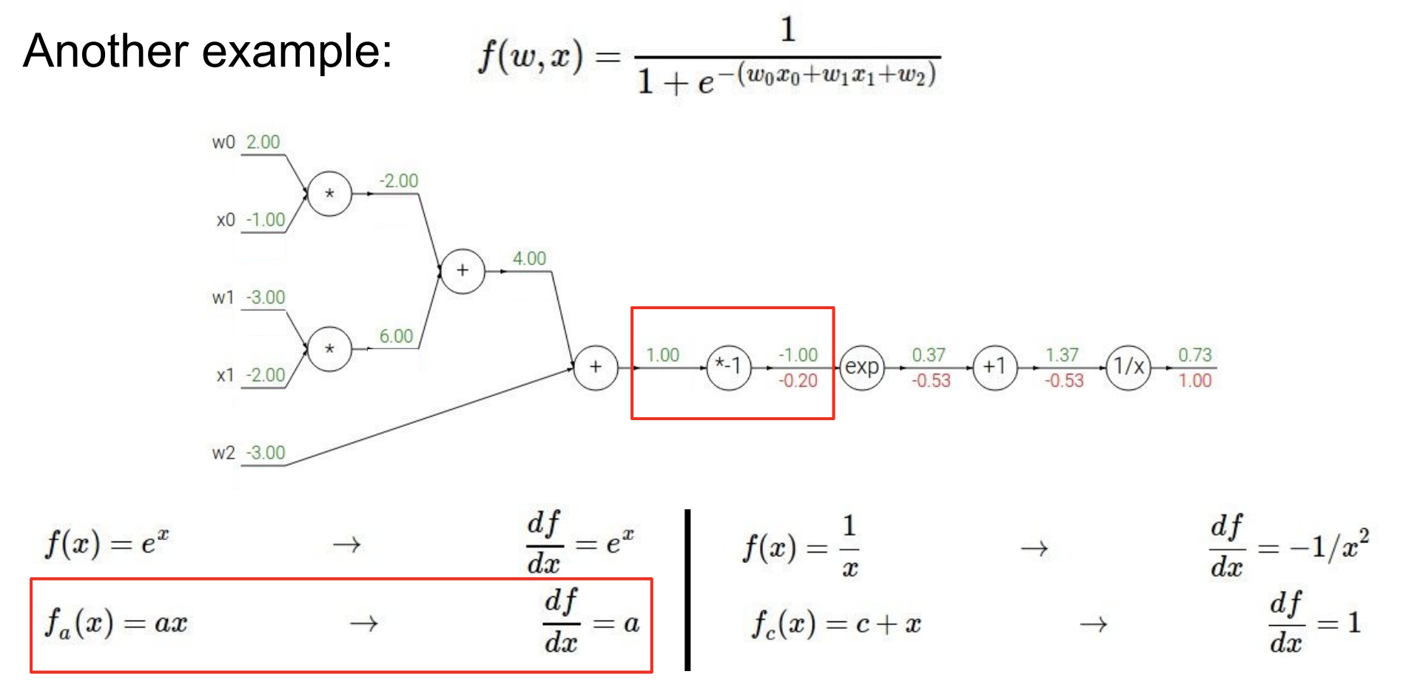
Backpropagation: Example

Slide 43
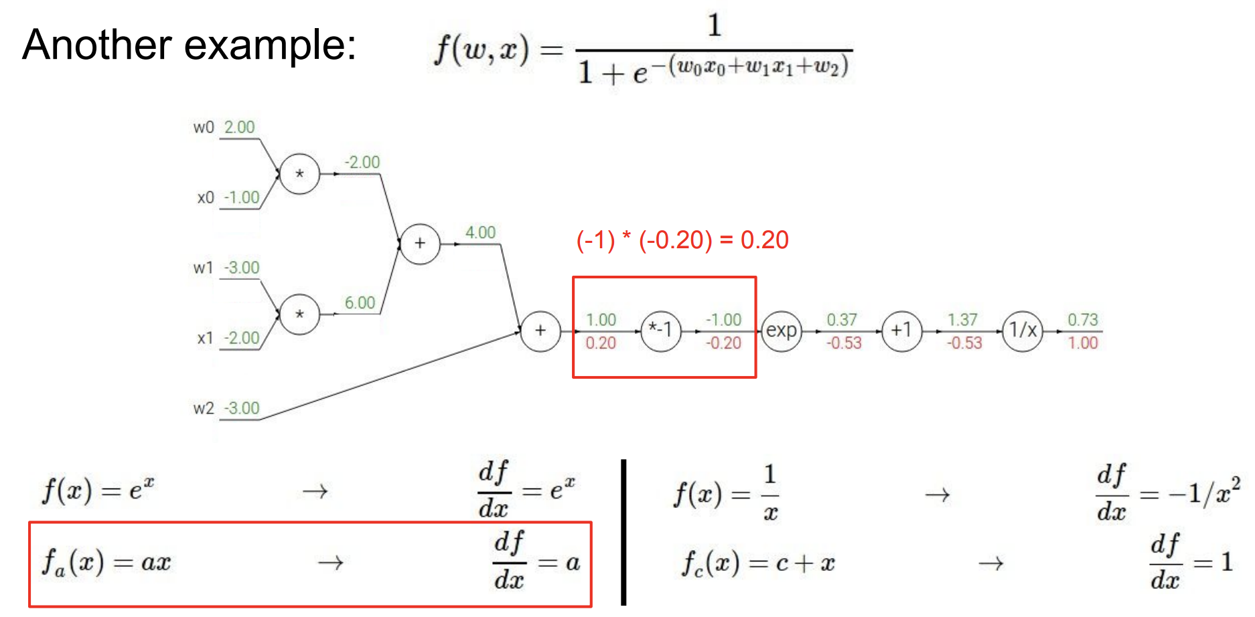
Backpropagation: Example

Slide 44
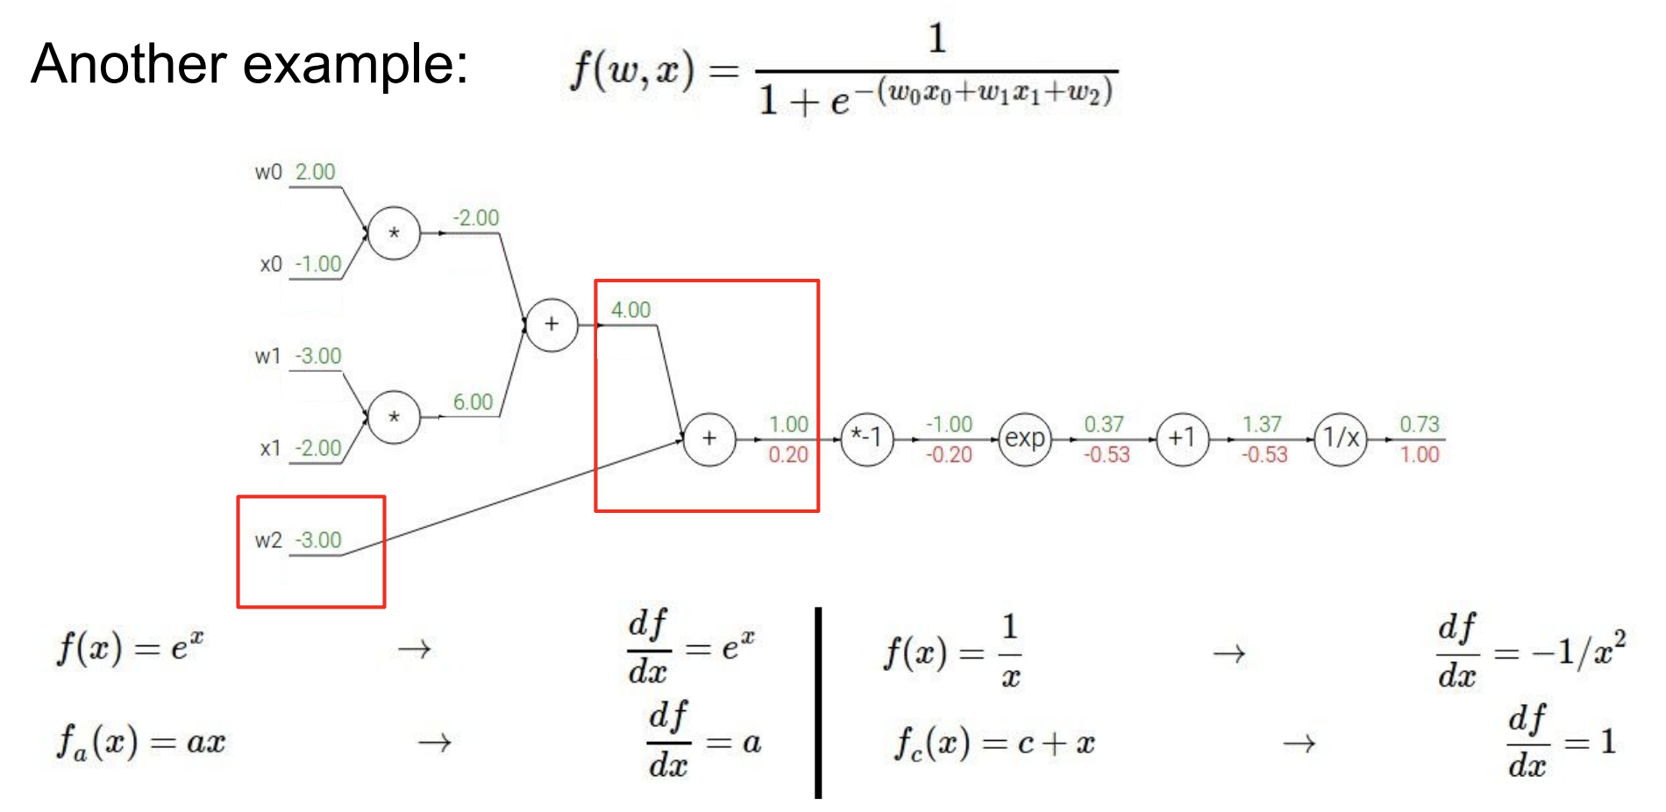
Backpropagation: Example

Slide 45
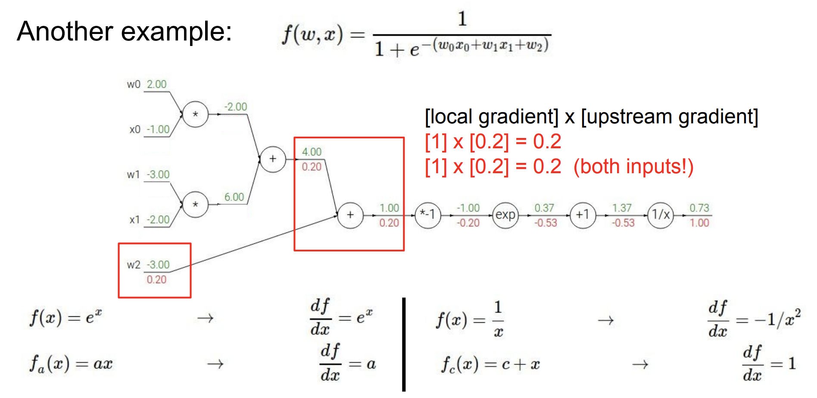
Backpropagation: Example

Slide 46
Implementation Details
R1 would take minimum distance over entire training set for every prototype
To minimize computation, minimize over random minibatch
Hyperparameters set to 0.05 and learning rate to 0.0001
What do you think of architectural details? Section 3.1 – any missing info? Can you reproduce?

Slide 47
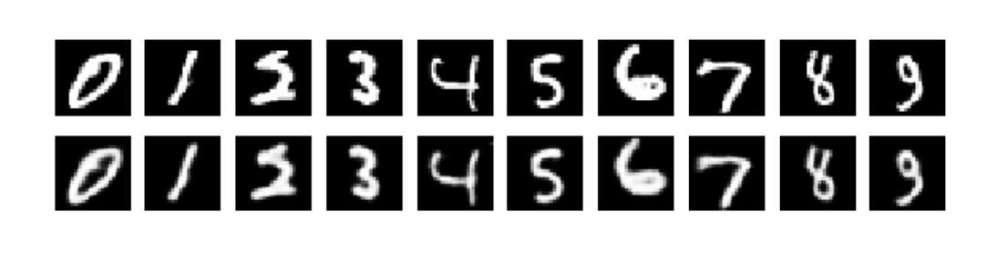
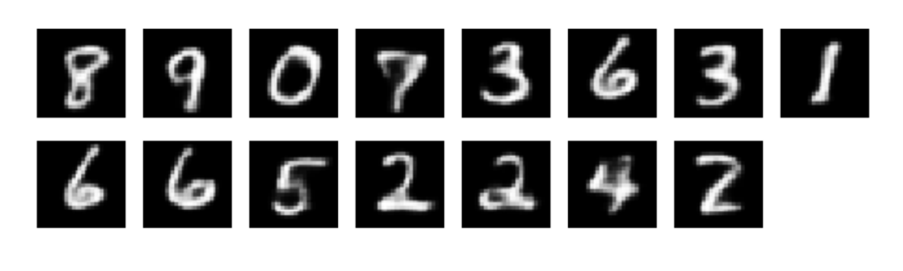
MNIST Data
Test accuracy above 99% and on par with LeCun
Reconstruction Error: 4.22
Learned prototypes:

Slide 48
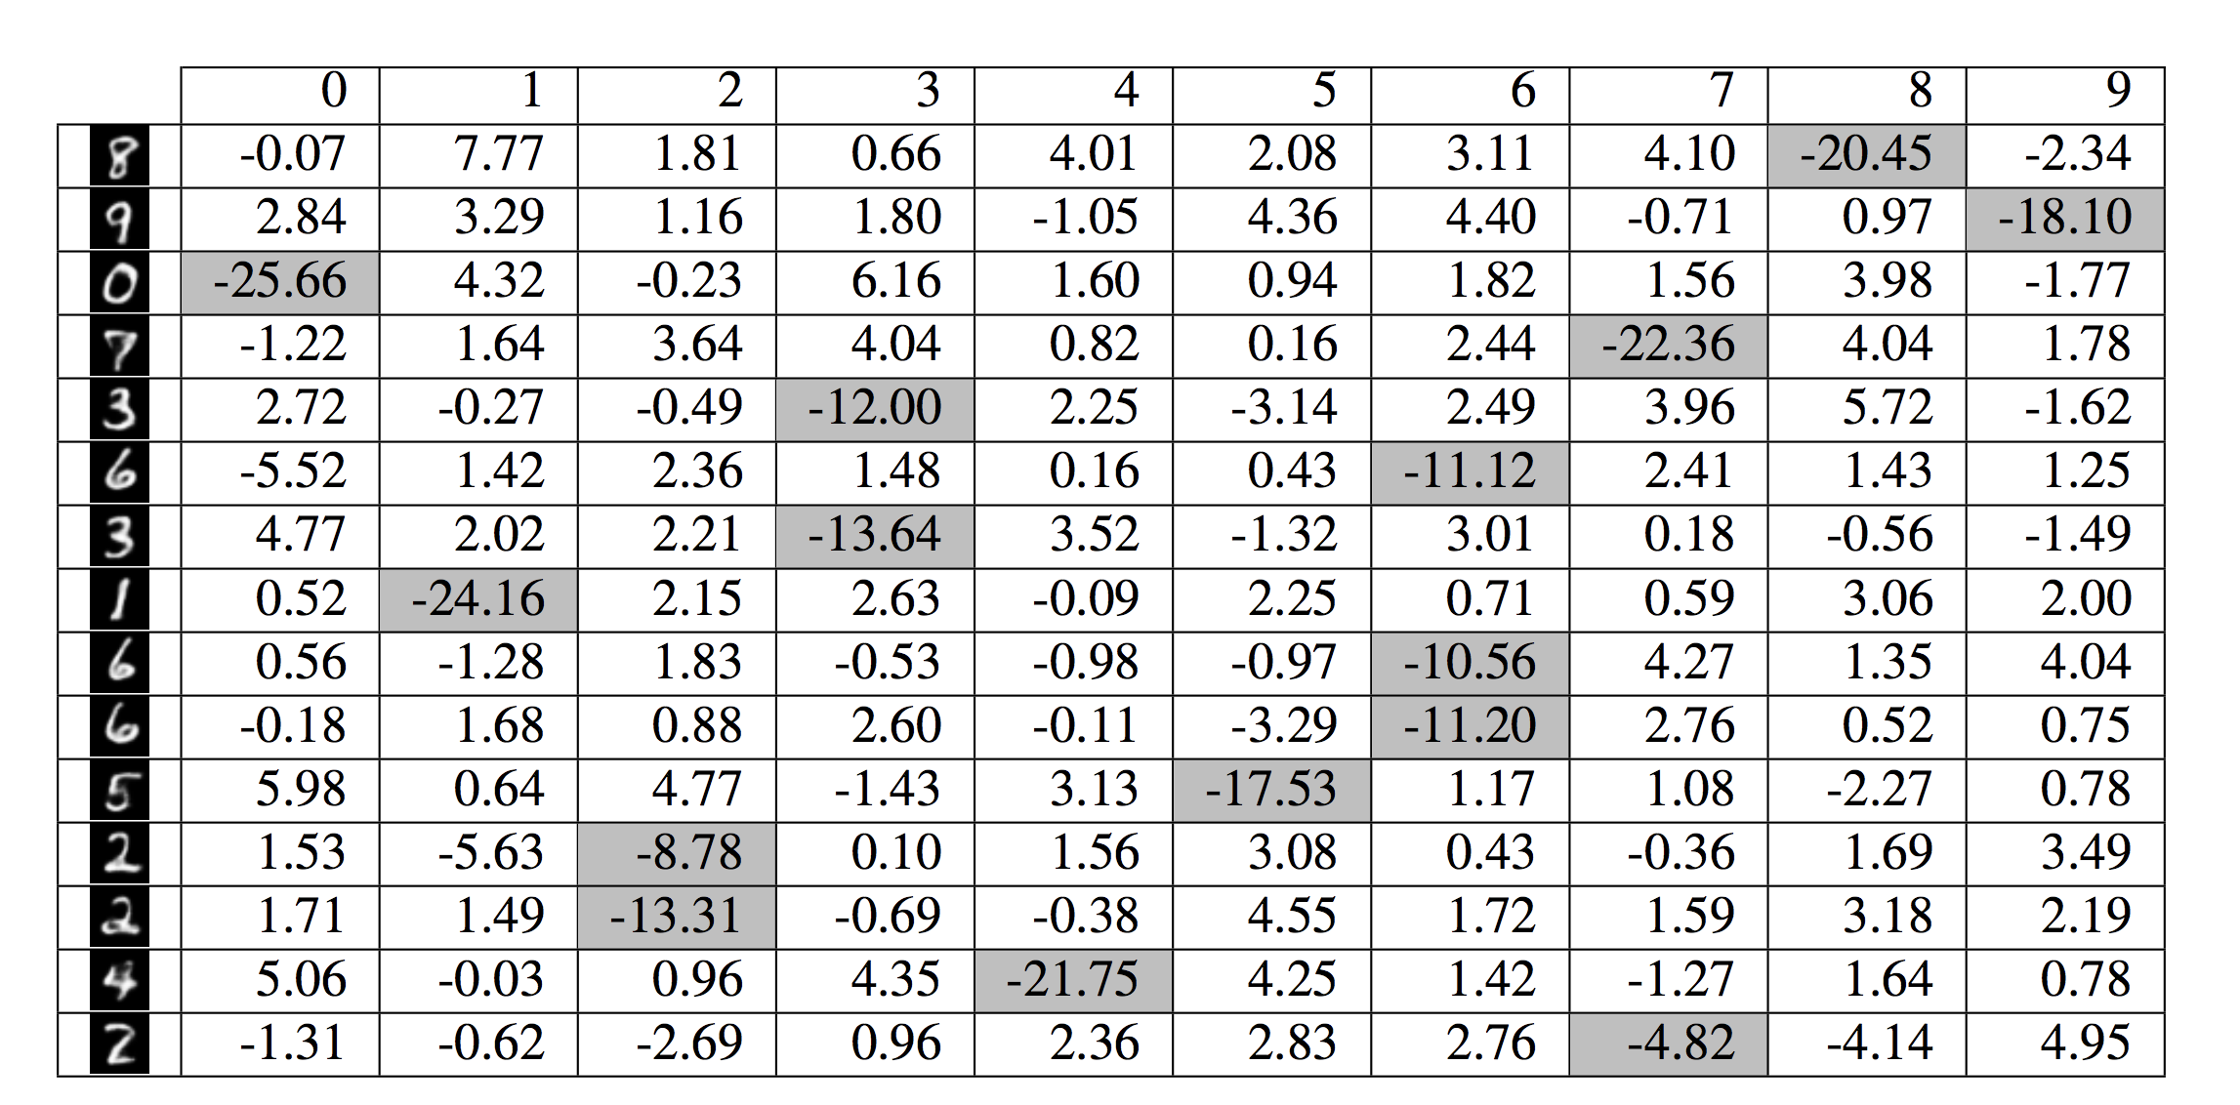
Learned Weight Matrix

Slide 49
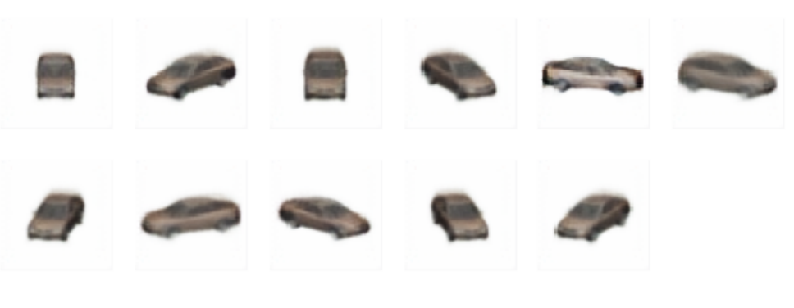
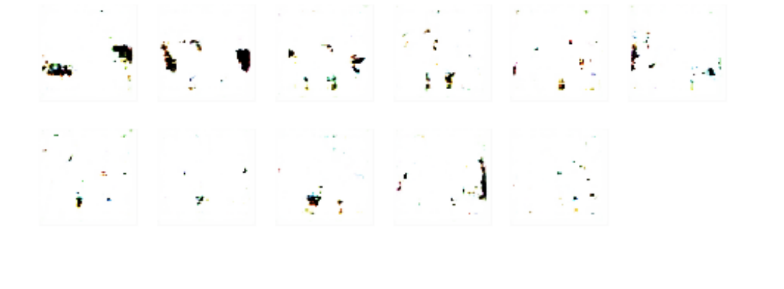
Ablation Study on Cars Data
Learned
Prototypes
Without
R₁ and R₂

Slide 50
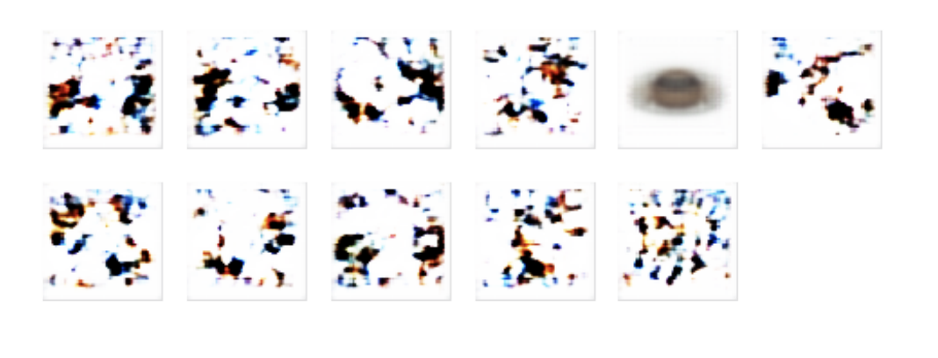
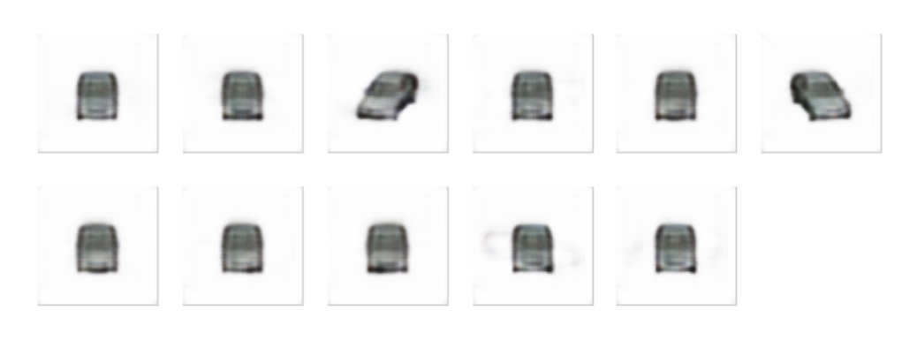
Ablation Study on Cars Data
Without
R₁
Without
R₂

Slide 51
Questions??

Slide 52
Let’s start the critique!

Slide 53
The Bayesian Case Model
Been Kim, Cynthia Rudin, Julie Shah

Slide 54
Contributions
A new Bayesian model, Bayesian Case Model (BCM)
Prototype clustering and subspace learning
Representative examples
Important features
Think of BCM as an interpretable clustering algorithm
Remark: If you know LDA, you know BCM!

Slide 55
Agenda
LDA (slightly modified)
Generative Model
Plate Notation
Choosing an Inference Method
Deriving Appropriate Equations
How is BCM different?
Prototype learning
Subspace learning
Experimentation

Slide 56
Latent Dirichlet Allocation
A classic model designed for identifying topics of documents
Each document is associated with a probability distribution over topics
Each word is associated with one topic which is sampled from the document’s probability distribution

Slide 57
LDA for Structured Data: Notation
M = Number of data points
N = Number of features
K = Number of clusters (known beforehand)

Slide 58
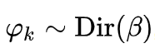
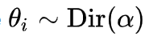
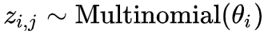
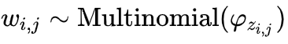
LDA for Structured Data
For each cluster k = 1 to K
Sample a distribution over feature values
For each data point i = 1 to M
Choose a distribution over clusters
For each feature j = 1 to N
Choose a cluster
Choose a feature value

Slide 59
Few Points
By that model, each feature is categorical and has same number of values
Restrictive assumption
Each data point is a member of multiple clusters
Soft cluster assignment
Each feature value corresponding to each data point is associated with a single cluster (sampled from the data point’s cluster distribution)

Slide 60
Few Points
What is the advantage of soft cluster assignments?
Why can’t each data point completely come from one single cluster?
Hard assignment

Slide 61
LDA for Structured Data
For each cluster k = 1 to K
Sample a distribution over feature values
For each data point i = 1 to M
Choose a distribution over clusters
For each feature j = 1 to N
Choose a cluster
Choose a feature value

Slide 62
Plate Notation

Slide 63
Agenda
LDA (slightly modified)
Generative Model
Plate Notation
Choosing an Inference Method
Deriving Appropriate Equations
How is BCM different?
Prototype learning
Subspace learning
Experimentation

Slide 64
Some Common Approaches
Variational Inference
Markov Chain Monte Carlo (MCMC)
Metropolis Hastings (last time)
https://ermongroup.github.io/cs323-notes/probabilistic/mh/
Gibbs sampling (now)
https://ermongroup.github.io/cs323-notes/probabilistic/gibbs/

Slide 65
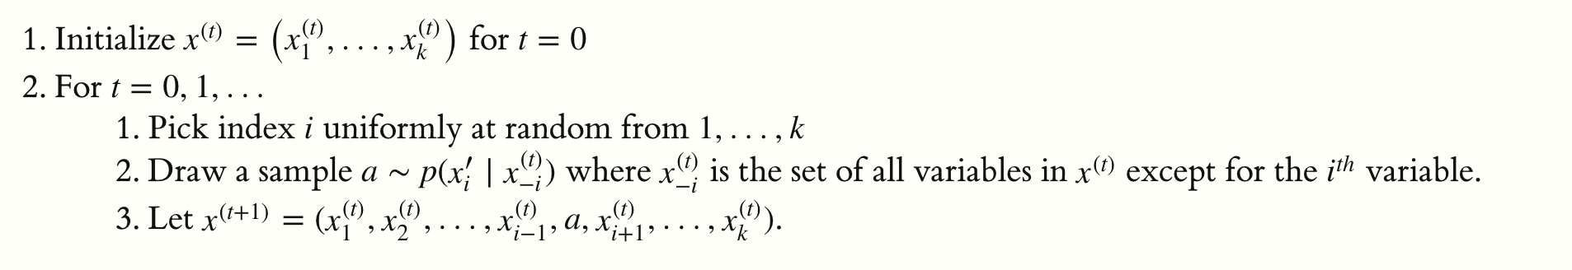
What is Gibbs Sampling?
Goal is to estimate values of a set of variables
Update one variable at a time while keeping all others constant
Repeat this process for T timesteps (ideally until a convergence condition is reached)

Slide 66
Gibbs Sampling: Our Main Task
Computing this distribution for each variable we would like to estimate
In our case, we only care about estimating z for every feature value of
every data point.

Slide 67
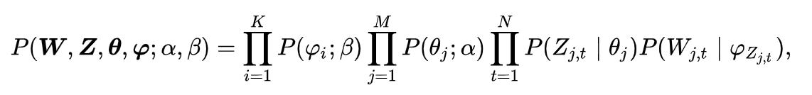
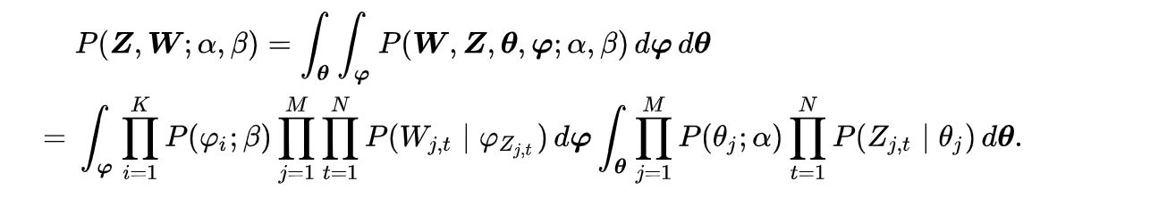
Gibbs Sampling: Update Equations
Total probability of the model
Integrate out the intermediate/nuisance parameters

Slide 68
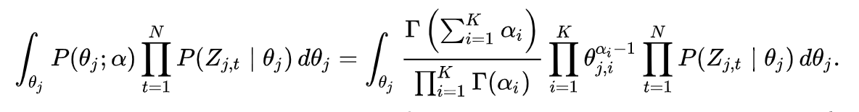
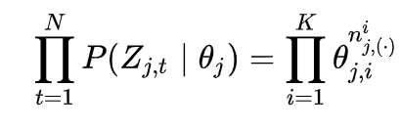
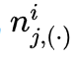
Gibbs Sampling: Update Equations
By definition of Dirichlet distribution
is the number of features of the j^{th} data point
that come from i^{th} cluster

Slide 69
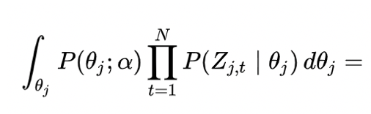
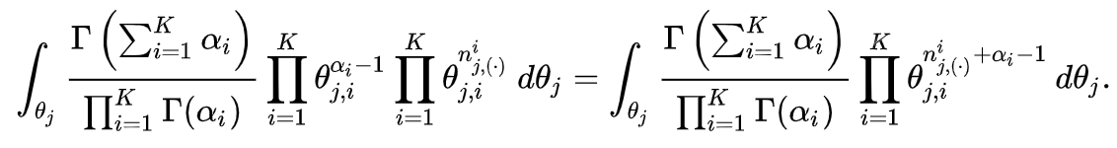
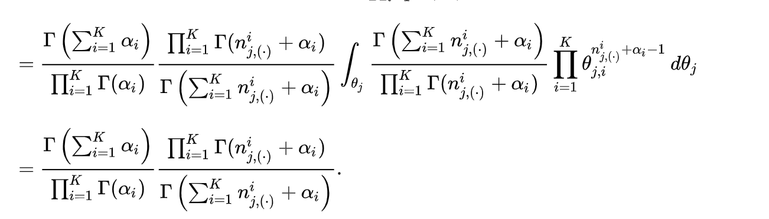
Gibbs Sampling: Update Equations

Slide 70
Gibbs Sampling: Update Equations
Total probability of the model
Integrate out the intermediate/nuisance parameters
Can be computed in a very similar way

Slide 71
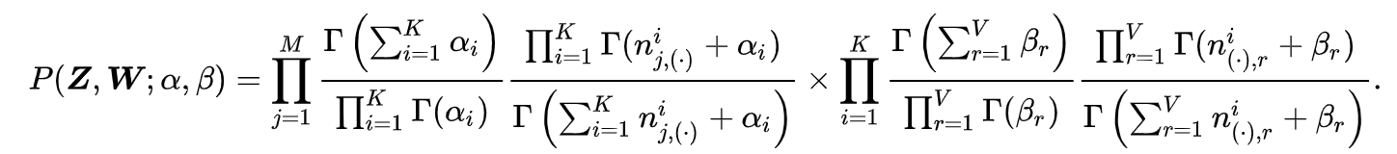

Gibbs Sampling: Update Equations
Note that intermediate parameters have been completely integrated out!
Our goal is to compute this conditional distribution:

Slide 72


Gibbs Sampling: Update Equations
Upon further simplification of the gamma functions

Slide 73
Agenda
LDA (slightly modified)
Generative Model
Plate Notation
Choosing an Inference Method
Deriving Appropriate Equations
How is BCM different?
Prototype learning
Subspace learning
Experimentation

Slide 74

Bayesian Case Model
Latent Dirichlet Allocation
Bayesian Case Model

Slide 75
Bayesian Case Model
Prototype
Subspace
Feature
Indicator
Each cluster is characterized by a subspace feature indicator and a prototype

Slide 76
Bayesian Case Model
Prototype
Subspace
Feature
Indicator
Prototype is an (example) data point (representative of the cluster)
Subspace feature indicator = [ 1 0 0 1 1 0 ]^{T}; 1 indicates feature is important

Slide 77

BCM: Generative Process
Sampling subspace feature indicators. Each indicator variable (1 or 0) is a
Bernoulli R.V. and 1 indicates that the corresponding feature j is important
for the cluster s.

Slide 78
BCM: Generative Process
Prototype data point for cluster s is sampled randomly from among all the N
data points.

Slide 79
BCM: Generative Process
Feature value distribution of feature j for cluster s. Features are categorical.

Slide 80
BCM: Generative Process
Prior which ensures that for features that are important for cluster s, all the points
associated with the cluster take values similar to the prototype’s corresponding
feature value.

Slide 81
BCM: Generative Process
Probability distribution over clusters for each data point i

Slide 82
BCM: Generative Process
Each feature value is sampled from one cluster (which in turn is sampled from the
data point’s probability distribution over the clusters

Slide 83
BCM: Generative Process
Each feature value is sampled from one cluster (which in turn is sampled from the
data point’s probability distribution over the clusters

Slide 84

LDA vs. BCM Example
Features are types, shapes, color.

Slide 85
Agenda
LDA (slightly modified)
Generative Model
Plate Notation
Choosing an Inference Method
Deriving Appropriate Equations
How is BCM different?
Prototype learning
Subspace learning
Experimentation

Slide 86

Classification Accuracy: SVM
Handwritten
Digit
20 Newsgroups

Slide 87

Classification Accuracy: Unsupervised
Handwritten
Digit
20 Newsgroups

Slide 88
User Study
24 participants (14 male, 10 female)
Each participant assigned to either LDA or BCM
Each participant looks at a recipe (only ingredients)
Assigns it to a one of the clusters
For LDA: presented top words in each cluster
For BCM: presented only prototype recipes (no subspace)

Slide 89
User Study
Classification accuracy:
85.9% for BCM,
71.3% for LDA
Is this task clear?
Is this pushing the utility of clustering too much to do classification?
How are the authors using ground truth labels?

Slide 90
Questions??

Slide 91
Let’s start the critique!

